Slide 1
Partner Asset Guidance
Anywhere Office
As businesses reimagine the future of work, teams should be empowered to connect and collaborate from anywhere. The new Anywhere Office digital marketing assets convey how Microsoft Surface can solve the problems that arise with disparate teams to help them stay productive, collaborate, and find new ways to work in this ever-changing work environment.
How to use the Anywhere Office assets
The Anywhere Office BOM includes four assets: a Guide, digital flyer, an email template, and digital social post assets. Each asset has white space included to make room for partner branding. CTAs can also be edited, as they currently direct the audience to the guide download.​ The solution guide will need to be hosted locally and any CTA’s will need to be updated with the new URL that points to the newly hosted solution guide.
1. Solution Guide: Using Microsoft Surface and Microsoft 365 in the new Anywhere Office.
Objective: To convey the value of Microsoft Surface and Microsoft 365 products as a solution for many challenges faced by organizations in the new normal of working from anywhere
Format: PDF and Adobe InDesign​
Editing tips Please use the associated AI file and edit assets in a compatible program (like InDesign).
2. Digital flyer: Explore the benefits of using Microsoft Surface devices and Microsoft 365.​
Objective: To convey the value of Microsoft Surface and Microsoft 365 products to enterprises in a quick, easy-to-digest way
Format: PDF and InDesign​
Editing tips Please use the associated AI file and edit assets in a compatible program (like InDesign).
3. Email template: Explore the benefits of using Microsoft Surface.​ Built for bulk send but can be easily customized for a personal send by adding a personal greeting and sign-off the email with your name and contact information
Objective: To highlight how organizations can remain productive in the Anywhere Office and drive to the guide where the audience can learn how Microsoft Surface and Microsoft 365 products can support them
Format: OFT
Editing tips To build the OFT email, choose the OFT file from the eMail Templates folder. Add the name of the recipient and your name in the introductory paragraph. Add your email address to the “Contact me” link at the bottom of the email. For the email template, edits must be made in a Microsoft Office-compatible program (like Microsoft Outlook).
4. Digital social assets: Two creative assets , one animated and one static, built for use on social media platform LinkedIn.
Objective: To convey the value of Microsoft Surface and Microsoft 365 products in a manner conducive to social media that is shareable and entices the audience to learn more
Format: AI, PSD, XD, PNG, and MP4
Editing tips: Digital social assets will need to be edited in a tool like Adobe After Effects.
Note: Use image copy provided when posting to social media
© 2020 Microsoft Corporation. All rights reserved. This document is provided “as-is.” Information and views expressed in this document, including URL and other Internet Web site references, may change without notice. You bear the risk of using it. This document does not provide you with any legal rights to any intellectual property in any Microsoft product. You may copy and use this document for your internal, reference purposes.
https://www.microsoft.com/en-us/surface/business

Slide 2
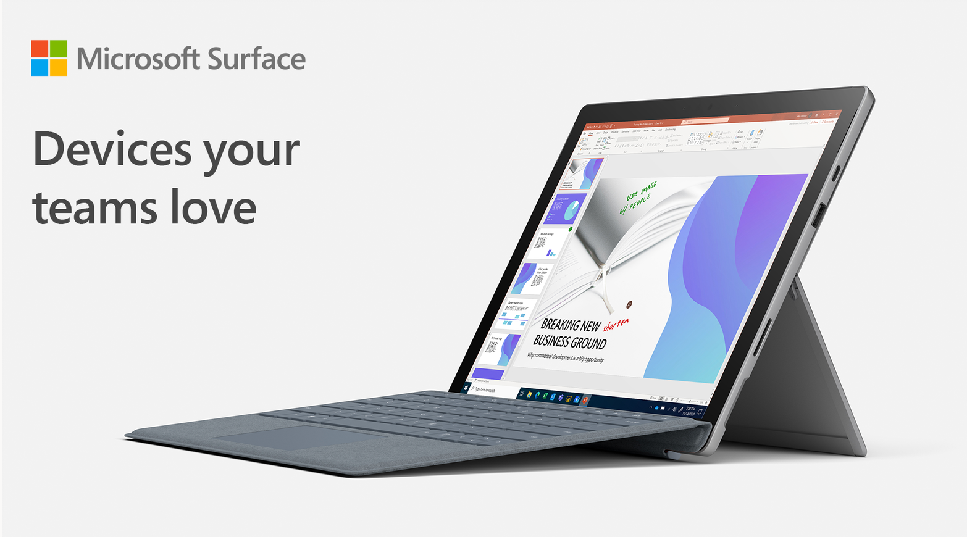
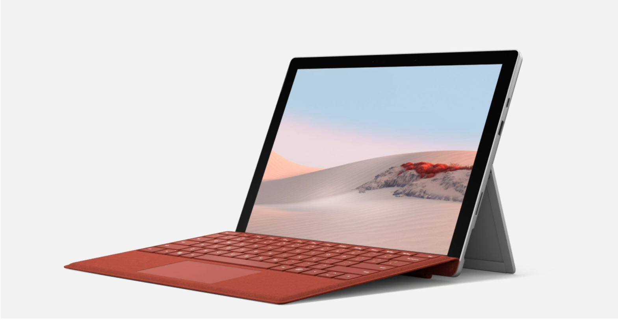
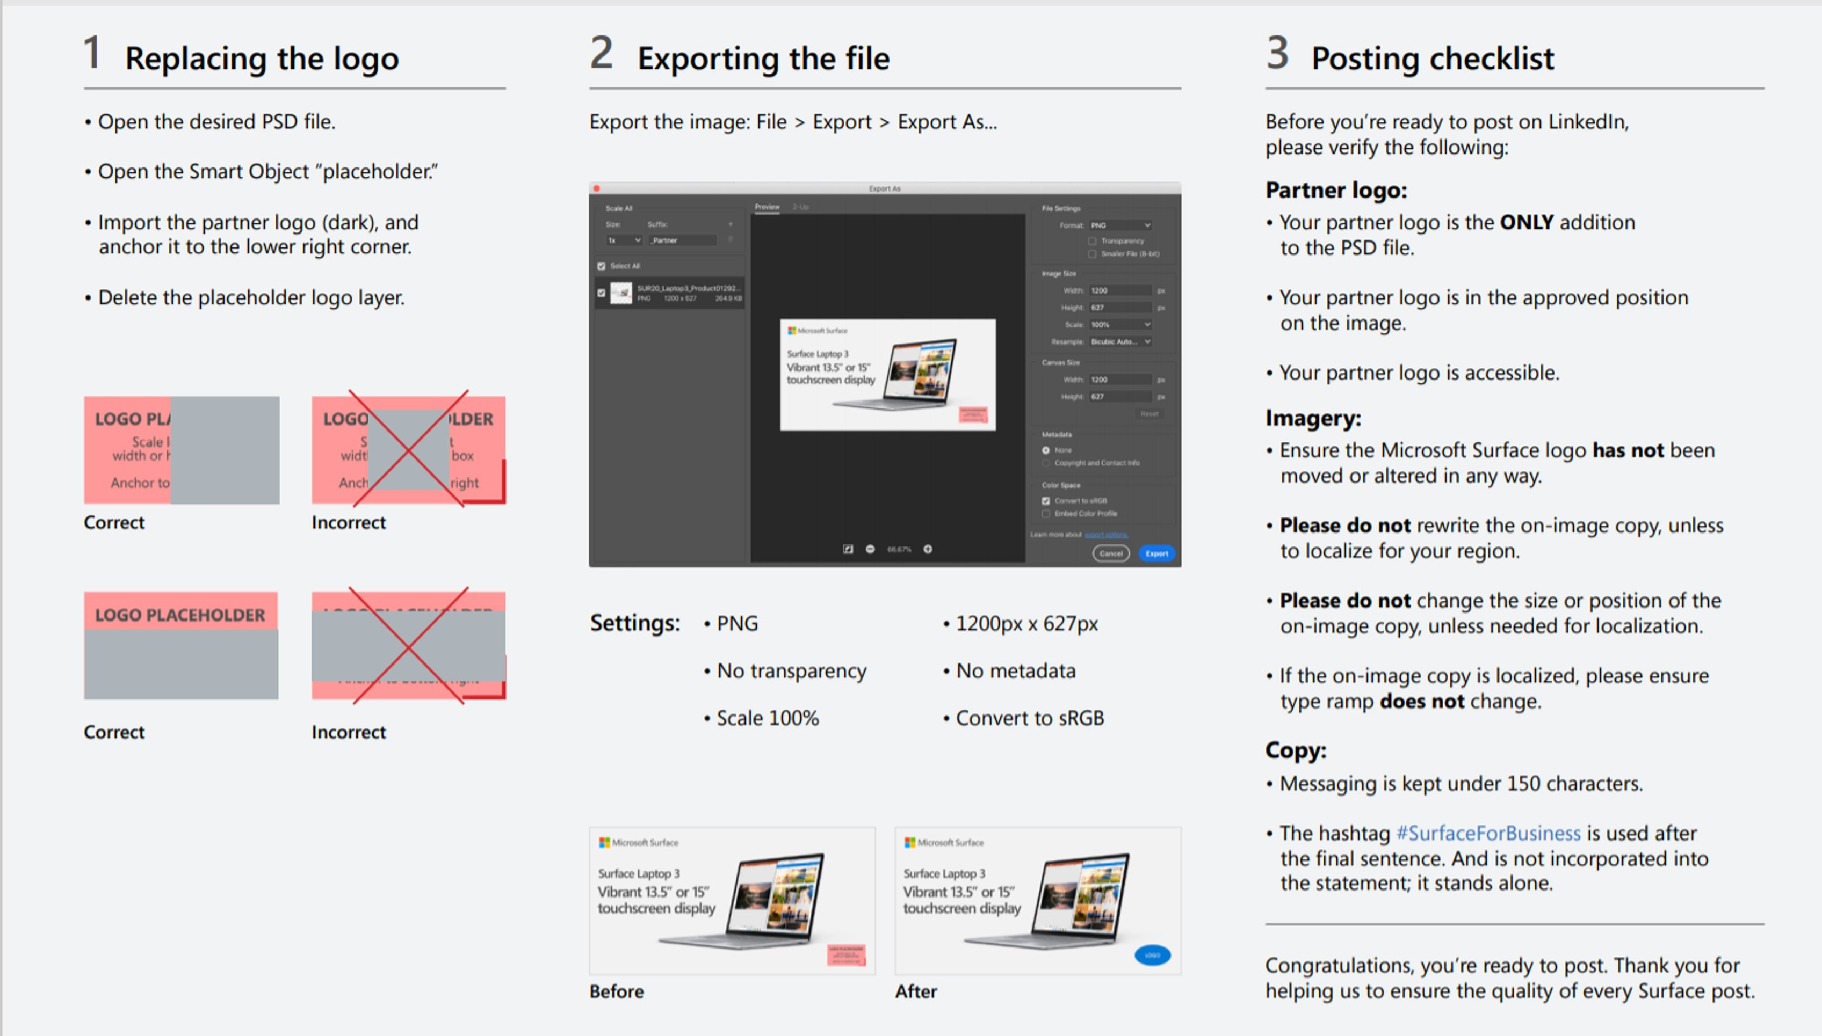
Instructions for how to build your social post
All social posts were built for use on the LinkedIn platform. These social posts can be leveraged for use on owned and operated (O&O) LinkedIn, Facebook, and Twitter handles given that they have similar spec requirements. Approved social copy and links to the assets are outlined below. When posting to O&O social media channels, use the copy in the copy grid that corresponds to the approved imagery and link to the Anywhere Office Solution Guide (which will need to be hosted locally.)
_{Asset Location + Title} | _{Thumbnail} | _{File type} | _{Post copy} | _{CTA}
Social contextual post | The new Anywhere Office |  | PNG | Employees may work from a different location every day – from the office, to home, to a customer site, or in the field. Help them work from anywhere with devices they love while reducing complexity for IT. #SurfaceForBusiness | Read our solution guide: The Anywhere Office
To come |  | MP4 | Employees may work from a different location every day – from the office, to home, to a customer site, or in the field. Help them work from anywhere with devices they love while reducing complexity for IT. #SurfaceForBusiness | Read our solution guide: The Anywhere Office
Instructions on how to add your partner logo
© 2020 Microsoft Corporation. All rights reserved. This document is provided “as-is.” Information and views expressed in this document, including URL and other Internet Web site references, may change without notice. You bear the risk of using it.
This document does not provide you with any legal rights to any intellectual property in any Microsoft product. You may copy and use this document for your internal, reference purposes.
https://www.microsoft.com/en-us/surface/business

Slide 3
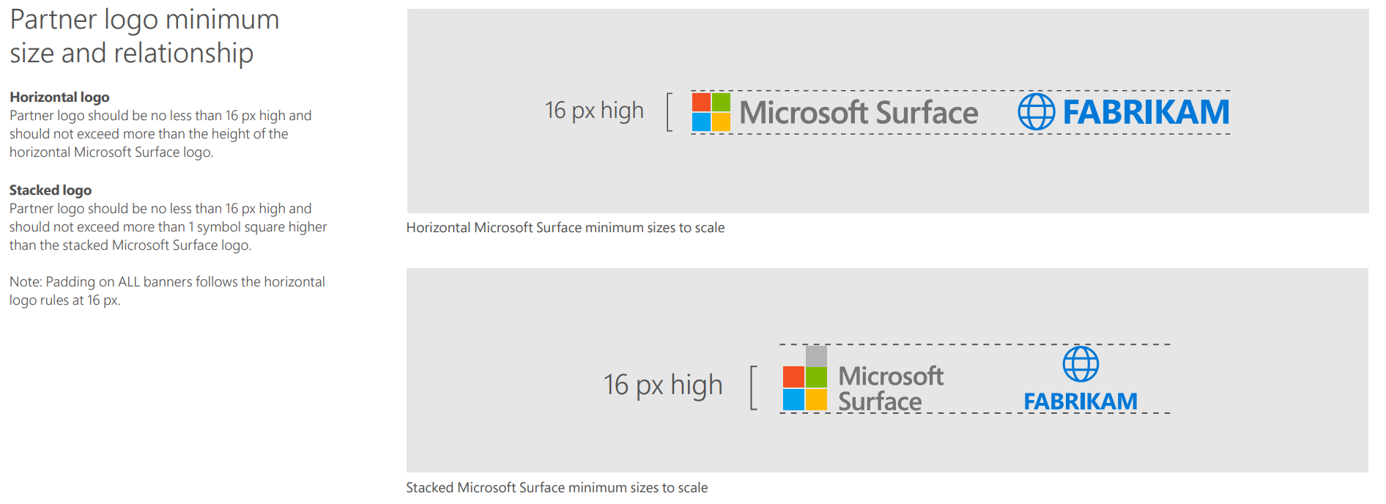
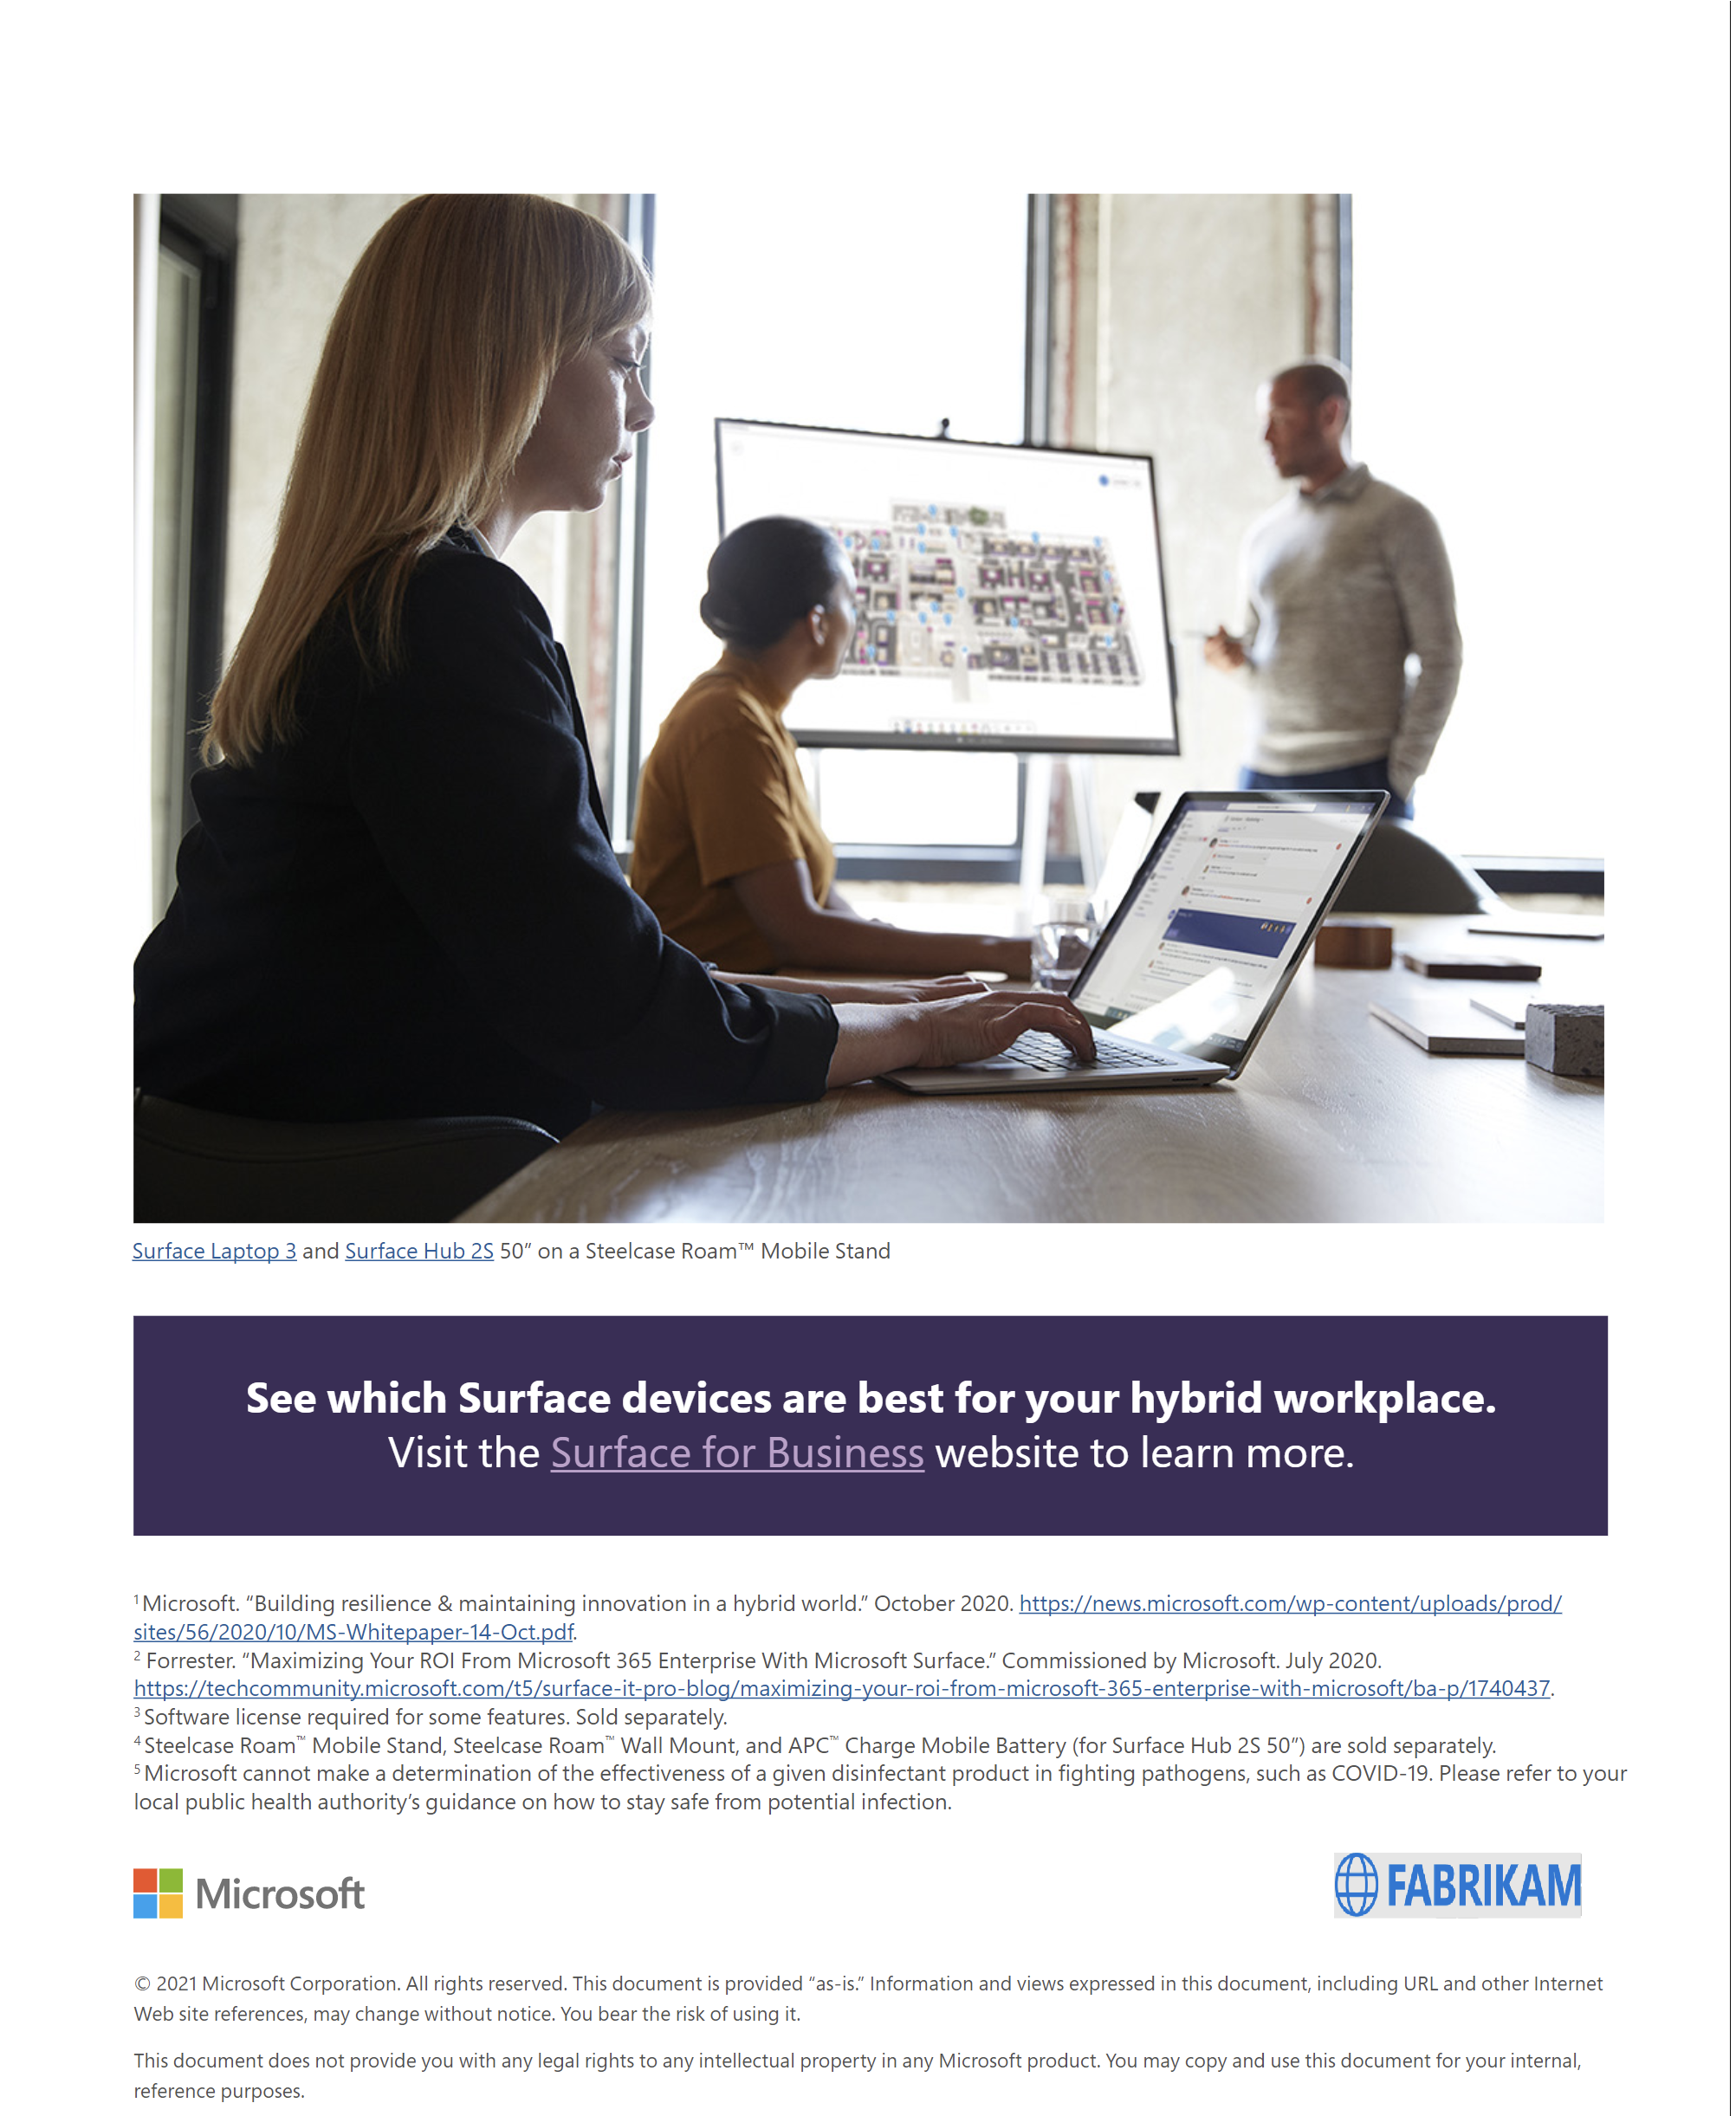
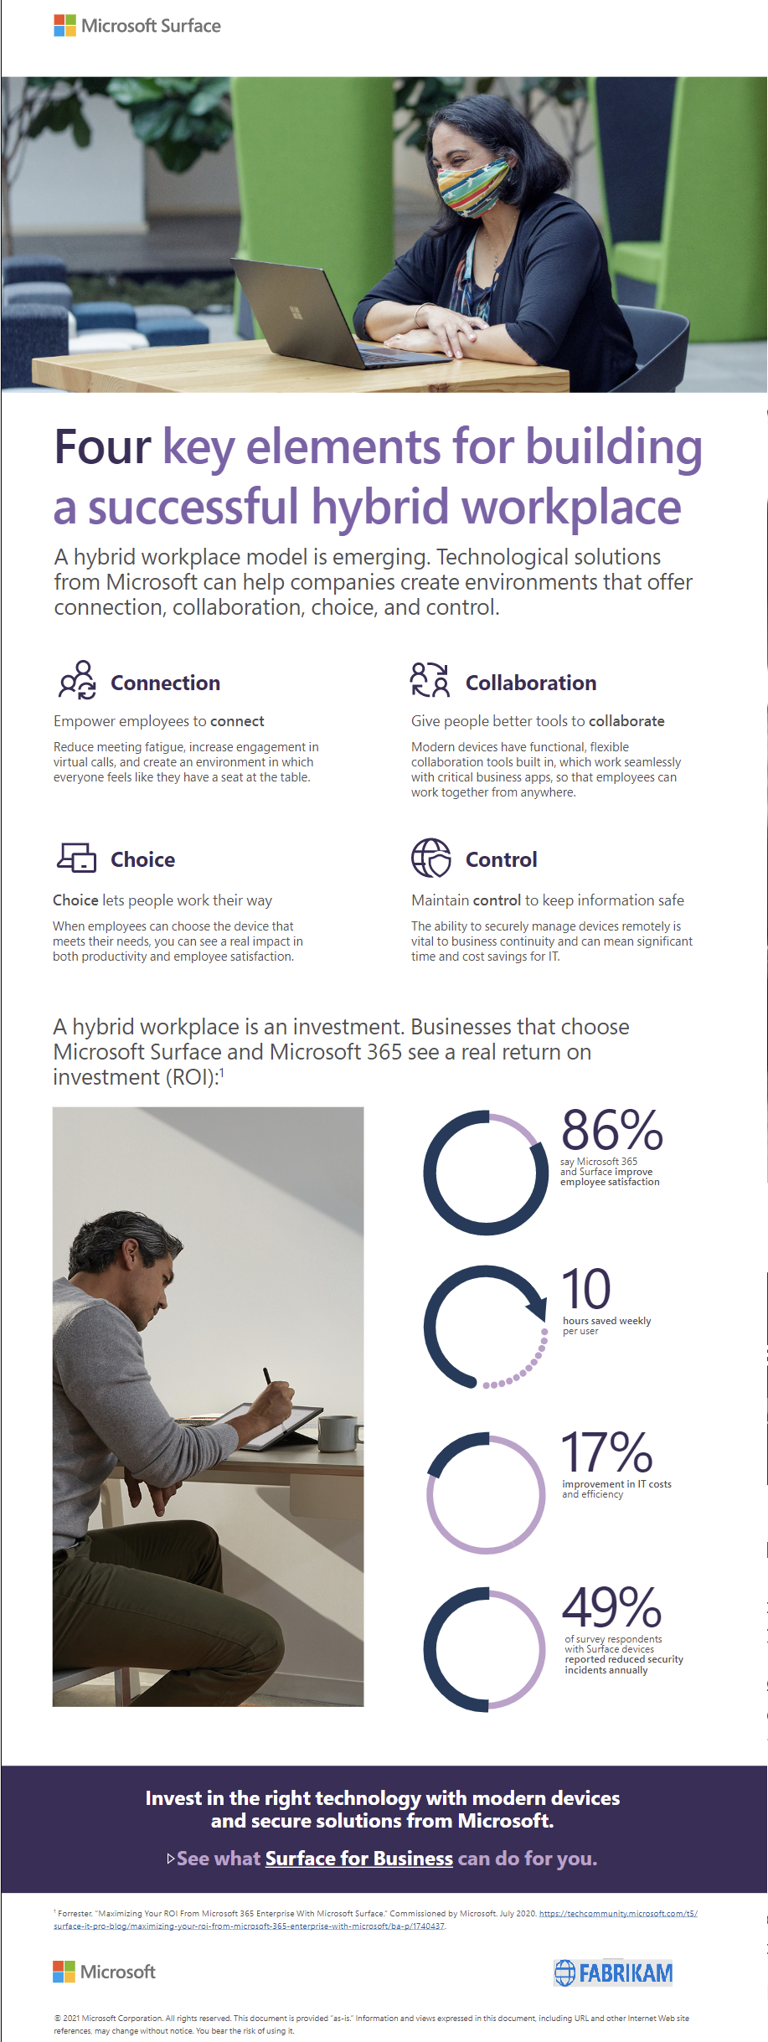
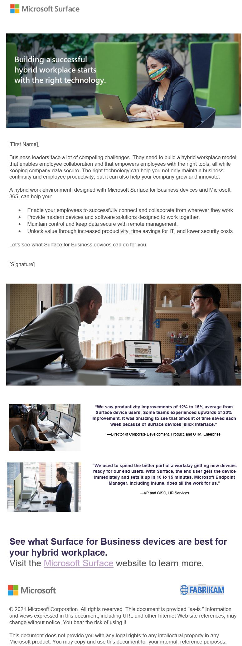
Co-branding eBooks, emails & flyers
A partner logo can be added to the bottom left corner each asset using the guidelines below.
Examples only
eBook
infographic
email

